Slide 1
Comparatives and Superlatives Comparing and Contrasting

Slide 2
Let’s start with comparatives and superlatives!
A comparative statement is used to show how two things are different.
A superlative statement is used to show how one thing or a group of similar things are more than or less than everything else.

Slide 3
Type of adjective | Adjective | Comparative | Superlative
1 syllable + 2 syllable adjectives ending in “y” | Old Big Large Friendly | Adj. + ER Older Bigger Larger Friendlier | Adj. + EST The Oldest The Biggest The Largest ** The Friendliest ***
2 syllable adjectives and more | Crowded Boring Interesting Polluted | MORE + Adj. More crowded More boring More interesting More polluted | THE MOST + Adj. The most crowded The most boring The most interesting The most polluted
Irregular patterns | Good Bad Far | Better Worse Further / farther | The best The worst The furthest/farthest

Slide 4
Comparatives:
You can tell someone that there is a large difference
between two things by using the following words:
Far / a lot / much / much, much…
Ex.) New York is much, much larger than Seattle.
She’s far prettier than her sister.
He’s much more clever than his sister.
For describing small differences you can use
a little (bit) or slightly.
Ex.) He’s slightly taller than his friend.
We’re a little (bit) older than our younger brothers.

Slide 5
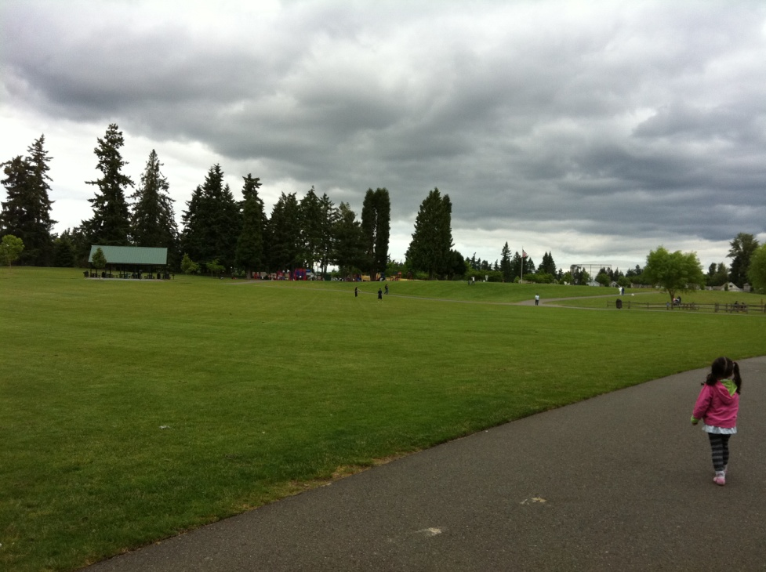
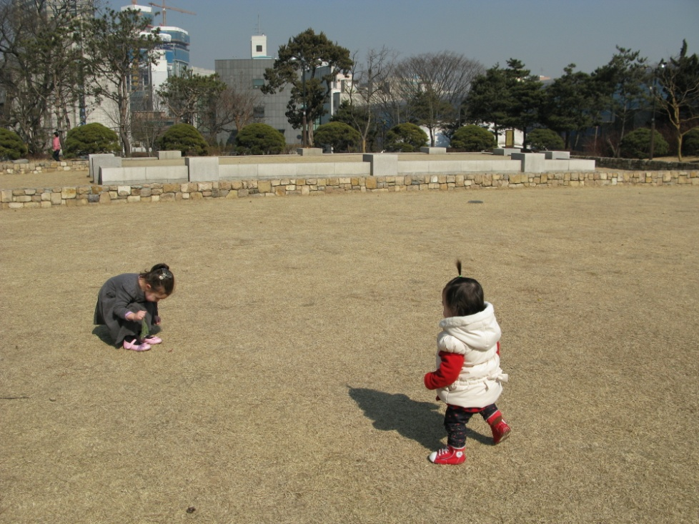
Try it with these two photos:

Slide 6
MORE COMPARISONS:
Not as… as… ex.) Dogs aren’t as cute as cats. / Snakes aren’t quite as scary as crocodiles. (smaller difference)
!!!!! – the order is VERY important. “Cats aren’t as cute as dogs” has a TOTALLY different meaning.
As… as… (comparing two things that are the same) Ex.) Girls are as smart as boys. / Cricket is as exciting as watching paint dry. / It’s just as good as before.
Less ex.) Is life in Daegu less exciting than life in Seoul? / Swimming is less exhausting than running.

Slide 7
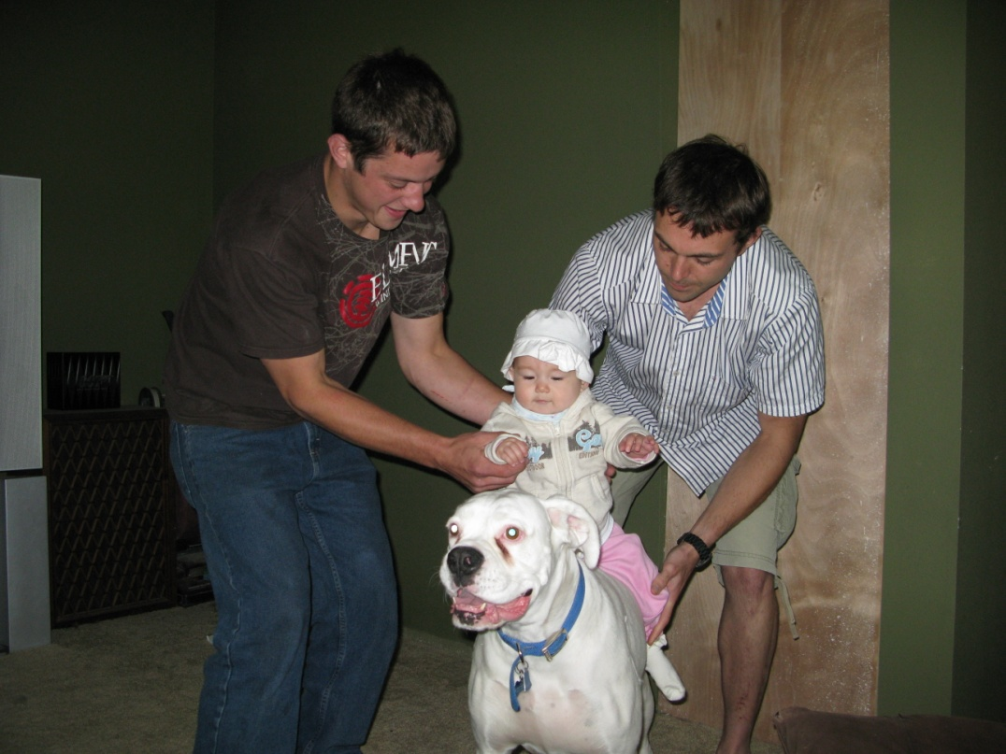
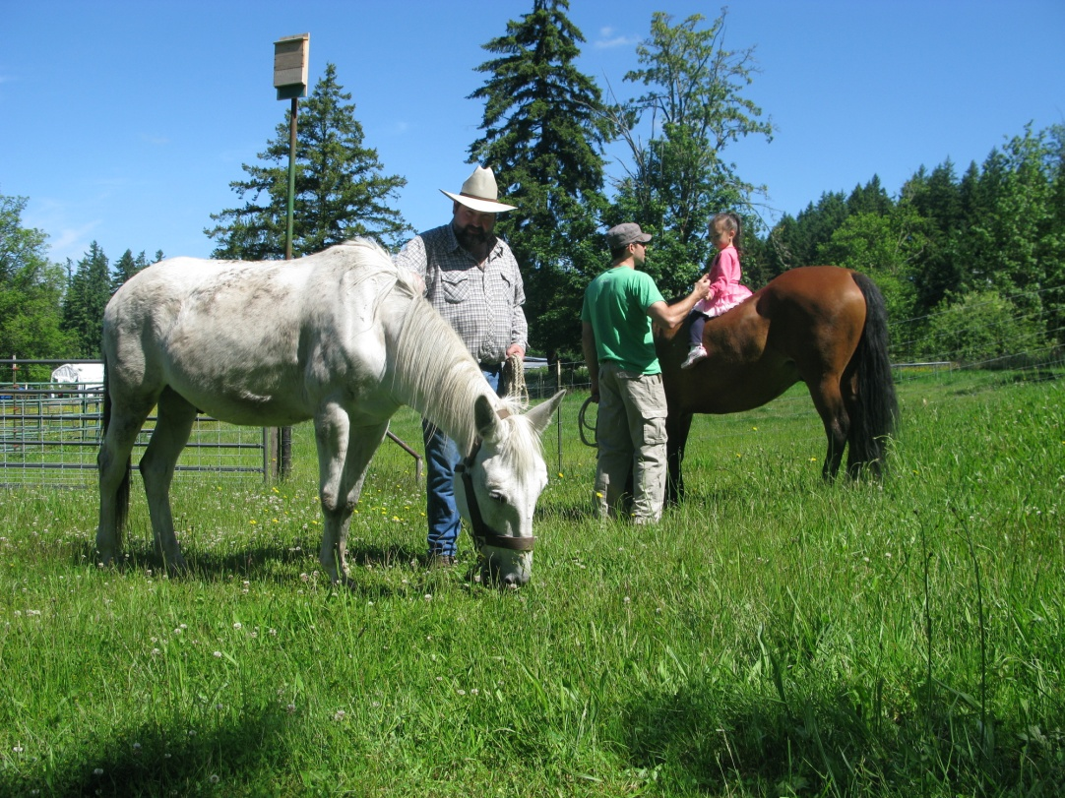
Try it with these two photos.

Slide 8
Superlatives:
By far the most… / ~est.
My great grandmother is by far the oldest person in
my family.
One of the most / ~est.
Tolkien is one of the most popular authors in the
world.
The second / third most… / ~est.
Daegu is the third largest city in South Korea.
The least.
I bought the least expensive watch.

Slide 9
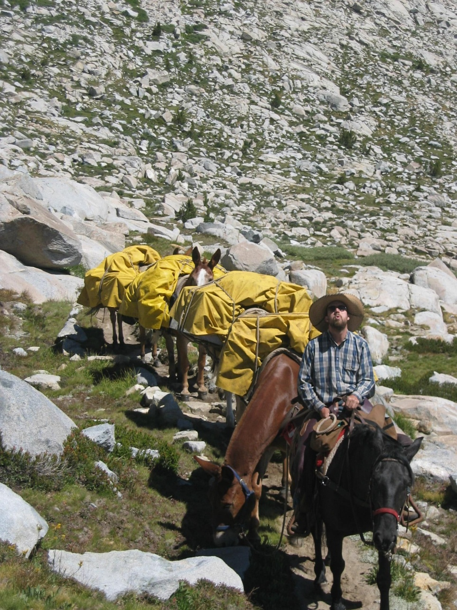
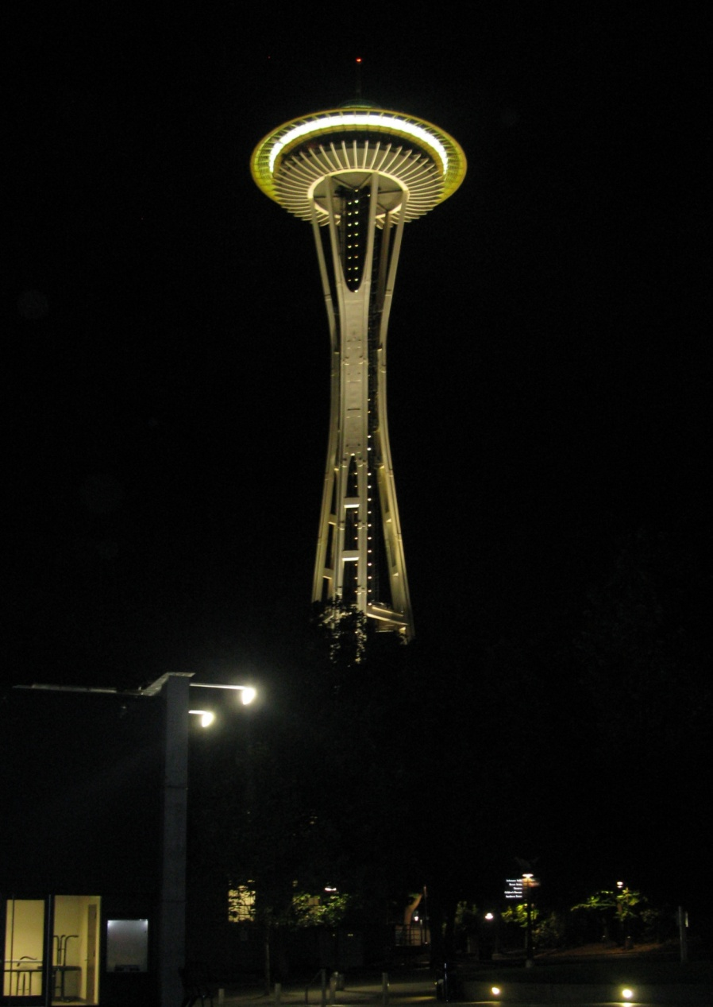
Try it with these two photos.

Slide 10
There is another way to show differences and similarities between two things. You can use these words:
Contrast
in contrast
however
but
yet
in contrast to
different from
on the other hand
while
whereas
unlike
Compare
Likewise
similarly
both…and
neither…nor
Not only…but also
Like
Similar to

Slide 11
Read this paragraph and choose the correct word.
Apartment Life
Though there are many similarities, life is better on the top floors of an apartment. One similarity is that (both/not only) the top floors (and/but also) the lower floors have the same types and sizes of apartments.
In addition, renters on the top floor are (unlike/similar to) renters on the bottom floors in that they deal with the same parking, elevators and building staff. (Likewise/However), there are reasons to prefer the top
floors. The top floors are quiet (whereas/in contrast to) the noisy lower floors. Also, the views are better. On the top floors, you can see the entire city. (Different from/On the other hand), the views from the lower
floors are of buildings, cars and people. Finally, (unlike/likewise) top floor apartments, the sun never shines on the lower floors because there are too many tall buildings around. In conclusion, I prefer living on the top floors of apartments to the lower floors.

Slide 12
Read this paragraph and choose the correct word.
Apartment Life
Though there are many similarities, life is better on the top floors of an apartment. One similarity is that (both/ not only) the top floors (and/ but also) the lower floors have the same types and sizes of apartments.
In addition, renters on the top floor are (unlike/ similar to) renters on the bottom floors in that they deal with the same parking, elevators and building staff. (Likewise/ However), there are reasons to prefer the top
floors. The top floors are quiet (whereas/ in contrast to) the noisy lower floors. Also, the views are better. On the top floors, you can see the entire city. (Different from/ On the other hand), the views from the lower
floors are of buildings, cars and people. Finally, (unlike/ likewise) top floor apartments, the sun never shines on the lower floors because there are too many tall buildings around. In conclusion, I prefer living on the top floors of apartments to the lower floors.

Slide 13
Read this paragraph and choose the correct word.
Apartment Life
Though there are many similarities, life is better on the top floors of an apartment. One similarity is that (both/ not only) the top floors (and/ but also) the lower floors have the same types and sizes of apartments.
In addition, renters on the top floor are (unlike/ similar to) renters on the bottom floors in that they deal with the same parking, elevators and building staff. (Likewise/ However), there are reasons to prefer the top
floors. The top floors are quiet (whereas/ in contrast to) the noisy lower floors. Also, the views are better. On the top floors, you can see the entire city. (Different from/ On the other hand), the views from the lower
floors are of buildings, cars and people. Finally, (unlike/ likewise) top floor apartments, the sun never shines on the lower floors because there are too many tall buildings around. In conclusion, I prefer living on the top floors of apartments to the lower floors.

Slide 14
Read this paragraph and choose the correct word.
Apartment Life
Though there are many similarities, life is better on the top floors of an apartment. One similarity is that (both/ not only) the top floors (and/ but also) the lower floors have the same types and sizes of apartments.
In addition, renters on the top floor are (unlike/ similar to) renters on the bottom floors in that they deal with the same parking, elevators and building staff. (Likewise/ However), there are reasons to prefer the top
floors. The top floors are quiet (whereas/ in contrast to) the noisy lower floors. Also, the views are better. On the top floors, you can see the entire city. (Different from/ On the other hand), the views from the lower
floors are of buildings, cars and people. Finally, (unlike/ likewise) top floor apartments, the sun never shines on the lower floors because there are too many tall buildings around. In conclusion, I prefer living on the top floors of apartments to the lower floors.

Slide 15
Read this paragraph and choose the correct word.
Apartment Life
Though there are many similarities, life is better on the top floors of an apartment. One similarity is that (both/ not only) the top floors (and/ but also) the lower floors have the same types and sizes of apartments.
In addition, renters on the top floor are (unlike/ similar to) renters on the bottom floors in that they deal with the same parking, elevators and building staff. (Likewise/ However), there are reasons to prefer the top
floors. The top floors are quiet (whereas/ in contrast to) the noisy lower floors. Also, the views are better. On the top floors, you can see the entire city. (Different from/ On the other hand), the views from the lower
floors are of buildings, cars and people. Finally, (unlike/ likewise) top floor apartments, the sun never shines on the lower floors because there are too many tall buildings around. In conclusion, I prefer living on the top floors of apartments to the lower floors.

Slide 16
Read this paragraph and choose the correct word.
Apartment Life
Though there are many similarities, life is better on the top floors of an apartment. One similarity is that (both/ not only) the top floors (and/ but also) the lower floors have the same types and sizes of apartments.
In addition, renters on the top floor are (unlike/ similar to) renters on the bottom floors in that they deal with the same parking, elevators and building staff. (Likewise/ However), there are reasons to prefer the top
floors. The top floors are quiet (whereas/ in contrast to) the noisy lower floors. Also, the views are better. On the top floors, you can see the entire city. (Different from/ On the other hand), the views from the lower
floors are of buildings, cars and people. Finally, (unlike/ likewise) top floor apartments, the sun never shines on the lower floors because there are too many tall buildings around. In conclusion, I prefer living on the top floors of apartments to the lower floors.

Slide 17
Read this paragraph and choose the correct word.
Apartment Life
Though there are many similarities, life is better on the top floors of an apartment. One similarity is that (both/ not only) the top floors (and/ but also) the lower floors have the same types and sizes of apartments.
In addition, renters on the top floor are (unlike/ similar to) renters on the bottom floors in that they deal with the same parking, elevators and building staff. (Likewise/ However), there are reasons to prefer the top
floors. The top floors are quiet (whereas/ in contrast to) the noisy lower floors. Also, the views are better. On the top floors, you can see the entire city. (Different from/ On the other hand), the views from the lower
floors are of buildings, cars and people. Finally, (unlike/ likewise) top floor apartments, the sun never shines on the lower floors because there are too many tall buildings around. In conclusion, I prefer living on the top floors of apartments to the lower floors.

Slide 18
Read this paragraph and choose the correct word .
Apartment Life
Though there are many similarities, life is better on the top floors of an apartment. One similarity is that (both/ not only) the top floors (and/ but also) the lower floors have the same types and sizes of apartments.
In addition, renters on the top floor are (unlike/ similar to) renters on the bottom floors in that they deal with the same parking, elevators and building staff. (Likewise/ However), there are reasons to prefer the top
floors. The top floors are quiet (whereas/ in contrast to) the noisy lower floors. Also, the views are better. On the top floors, you can see the entire city. (Different from/ On the other hand), the views from the lower
floors are of buildings, cars and people. Finally, (unlike/ likewise) top floor apartments, the sun never shines on the lower floors because there are too many tall buildings around. In conclusion, I prefer living on the top floors of apartments to the lower floors.

